Slide 1
ASP.NET MVC CORE
Instructor: Edwin oduor

Slide 2

Quote of the day

Slide 3
Lesson objectives
User Login
Implement logout functionality

Slide 4
Lesson pre-requisites
In order to take full advantage of this section you need to have the following;
Computer with Visual Studio Installed.
Stable Network Connection.

Slide 5
Training methods and extra readings
TRAINING METHODS FOR THIS LESSON
EXTRA READINGS
Lecturing Method – This is the main method of training to be adopted in this lesson with illustrations and practical coding examples.
Discussion Method - This method will be adopted periodically whereby learning will be derived principally from the students brainstorming together, rather than from the trainer. Three main types of discussions will be used:
Directed discussion
Developmental discussion
Problem-Solving discussion
Home and Learn C#

Slide 6
User login

Slide 7
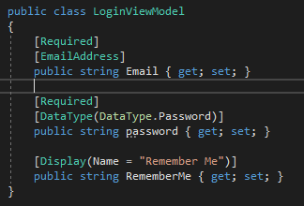
Since we have already implemented the signing functionality whereby the users can be added into the table and those users can go ahead and login into the system by providing the details that they used, to login into the system. For the users who have already registered for them to login then will have to create a login functionality that is going to check what the user has entered and then will determine if the user can login the system.
For us to create the login Functionality will require to have a model(LoginViewModel) in the ViewModel Folder for the controller will use the same controller that is AccountsController.

Slide 8

Next go to the Accounts Controller and create a method Login decorate it with HttpGet.
Create a view from the login IAction

Slide 9
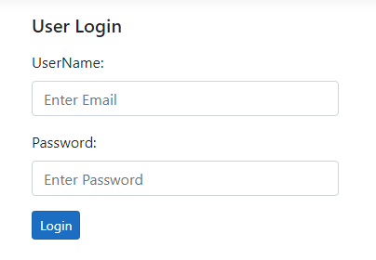
The View should look like this

Slide 10
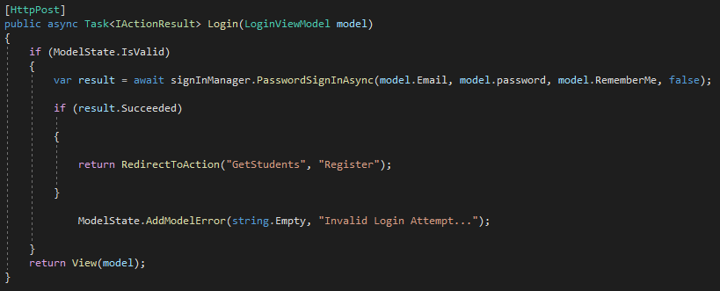
Login method HttpPost

Slide 11
IMPLEMENTING THE LOG OUT FUNCTIONALITY

Slide 12

To implement the log out functionality then will use a partial view. Will create a partial view and give it the name _LoginInfo.cshtml.
In the _Layout.cshtml will have the following
The partial name represents the name of the partial view that we have created, then in the partial view will have the following code.

Slide 13
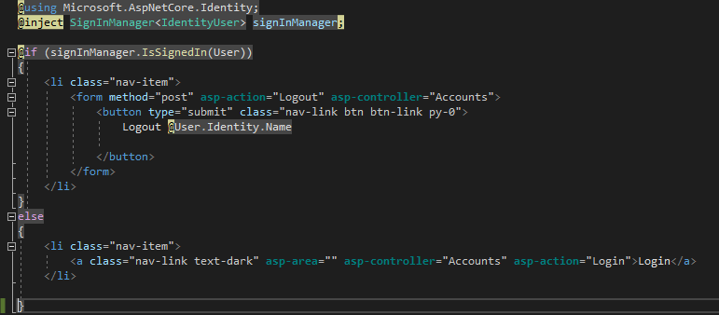
The partial name represents the name of the partial view that we have created, then in the partial view will have the following code. In the first line we are importing the name space then the second line we are injecting the signInManager

Slide 14
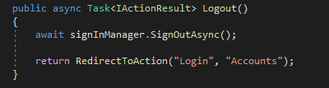
The Action Logout and the controller is Accounts, though at the moment we don’t have the action will have to implement it in the Accounts controller.
This is now the code for the accounts controller.

Slide 15
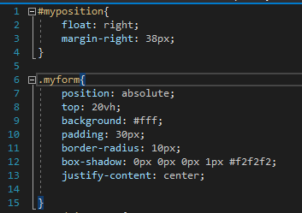
To format and Edit our login page, will add some CSS to our login. Will create a style sheet and in our style sheet will the following code.
With the above class applied to our form it will make the form shown at the center of the page and will contain some borders around the form.

Slide 16
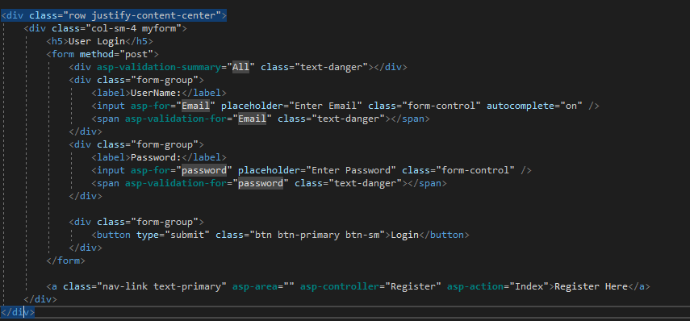
Will use the class myform to apply to our form.

